Slide 1

The Controlled-Autonomous Rover
Ben Brown, Ganquan Wen, Zisen Zhou, Nicholas Arnold, and Mohammed Uddin

Slide 2

Goal and Motivation
Implement a “RC” Car using an FPGA with distinct modes
Controlled
Autonomous
Add unique peripherals
Bluetooth for controls & live stats
Ultrasonic Sensor/Light Sensor to detect environment
Motors to drive the rover
Main Features
Autonomous mode! Implement a decision making vehicle based on feedback from sensors
Using Verilog and the FPGA to handle interactions between different peripherals
Notes:
MO

Slide 3
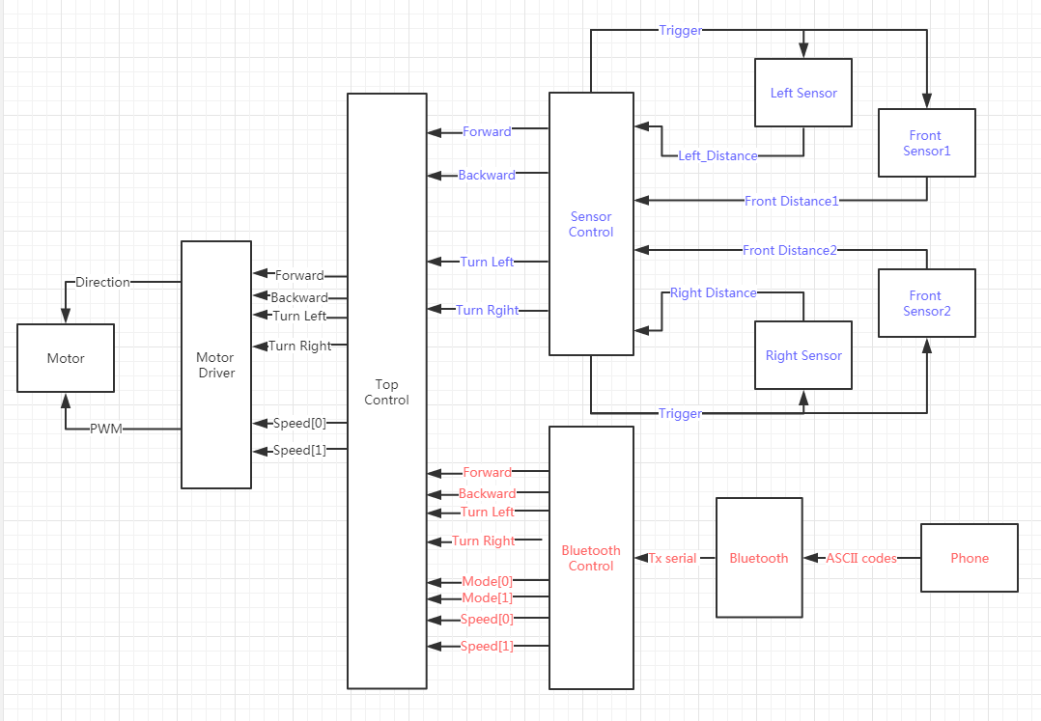
High Level Functionality
Notes:
Ben

Slide 4
Specification Overview
Motors
Take a barebones RC car base, and control the motor with varying speeds
Requirements: receive signals from either bluetooth module OR sensor feedback and drive the car
Bluetooth
Implement bluetooth controls via UART
Requirements: FPGA receives serial data through UART rx, parses this data, and produces accurate control for the motor
Sensors
Implement sensors Ultrasonic distance sensors to detect obstacles
Requirements: Send accurate and real time signals to FPGA, design an algorithm to decide how the steering and movement should behave autonomously
Notes:
MO

Slide 5
Detailed Functionality - Motors
2 DC Motors
Rear motor for forward/backward and speed
Front motor for turning
3 different speeds can be selected in manual mode
65%, 80% and 95% duty cycle respectively
Autonomous mode defaults to slowest speed
Different speeds implemented with pulse width modulation (PWM) of rear motor
Notes:
Ben

Slide 6
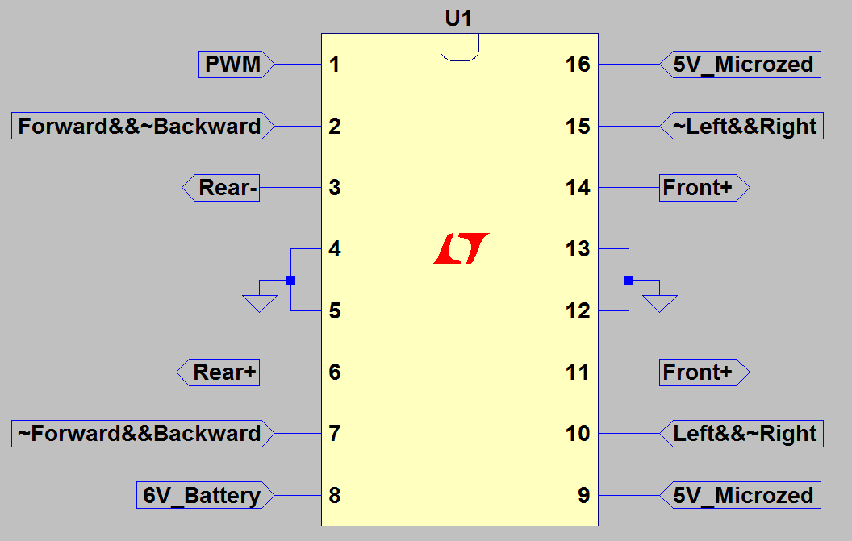
Motor Driver L293D
4 tri-states
2 Enable pins
Low current logic level signals in
Output pins output up to 0.6A each
PWM implemented by disabling and enabling Rear+ and Rear- outputs
Input
Input
Input
Output
Output
Output
Output
-
Input
Input
-
Notes:
Ben

Slide 7
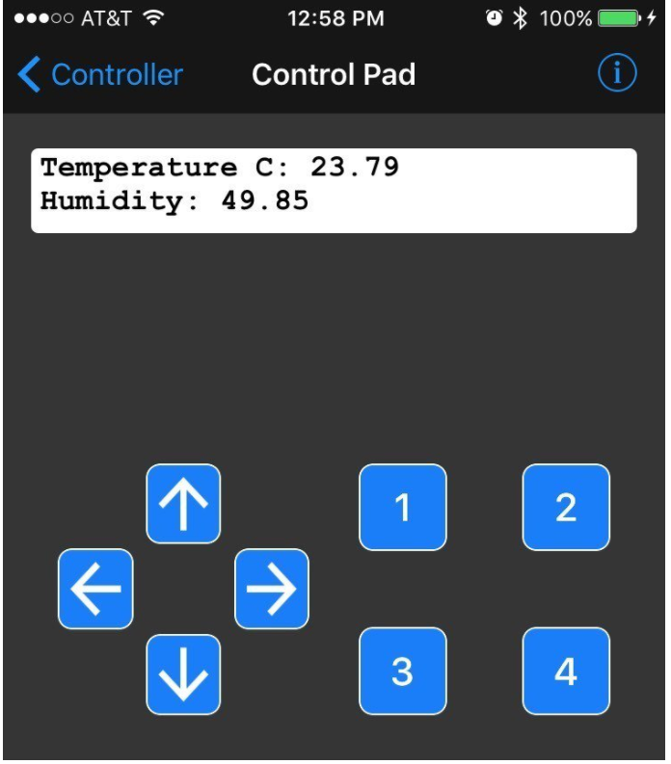
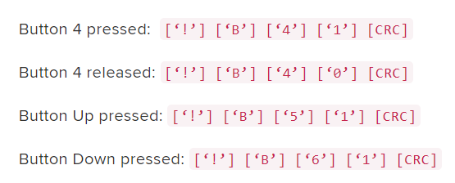
Detailed Functionality -Adafruit Bluetooth
BT button presses are sent as serial ASCII over the air then on the TX pin
Also can type in ‘a’ ‘c’ or ‘s’ for auto/ctrl/stop
Each Button Consists of 5 Bytes
Last is Cyclic Redundancy Check
UART Rx converts serial to Bytes
Parser reads them in & translates into button val
Controller listens to button & outputs control signals to motor controller for speed, mode, and directions
Notes:
NICK

Slide 8
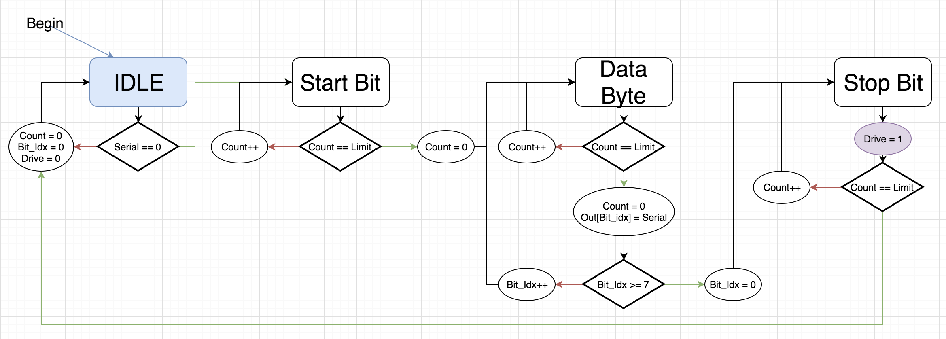
Bluetooth Rx Block Diagram
Notes:
NICK

Slide 9
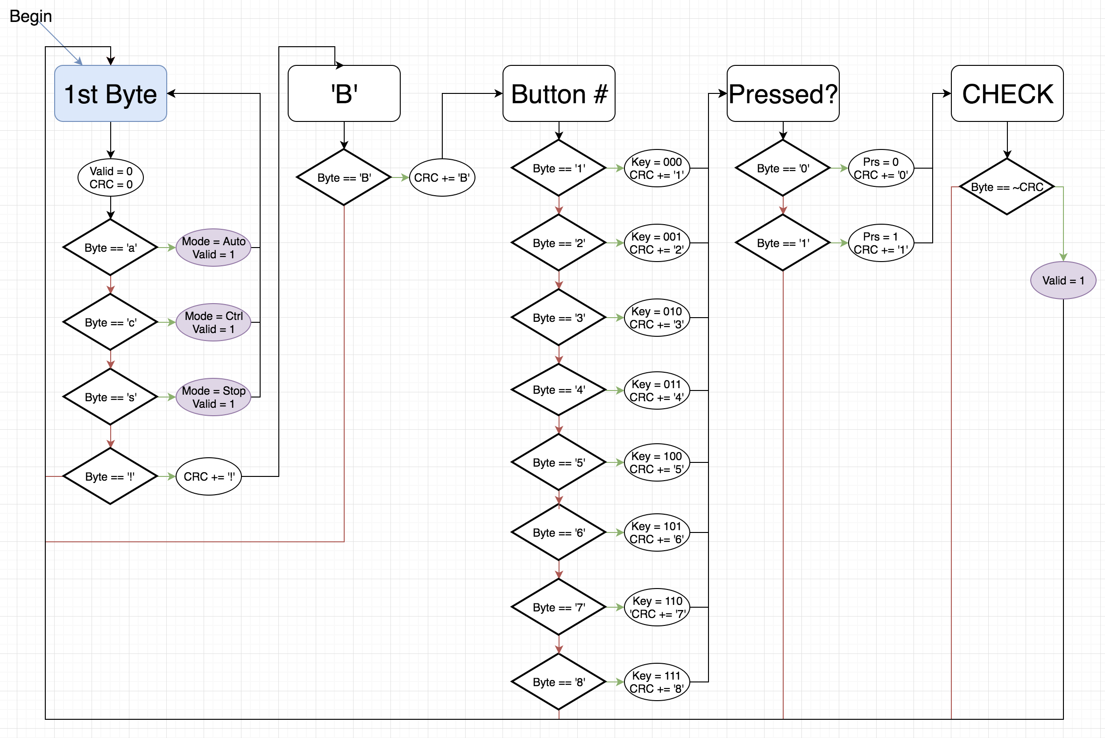
Command Parser
Notes:
NICK

Slide 10
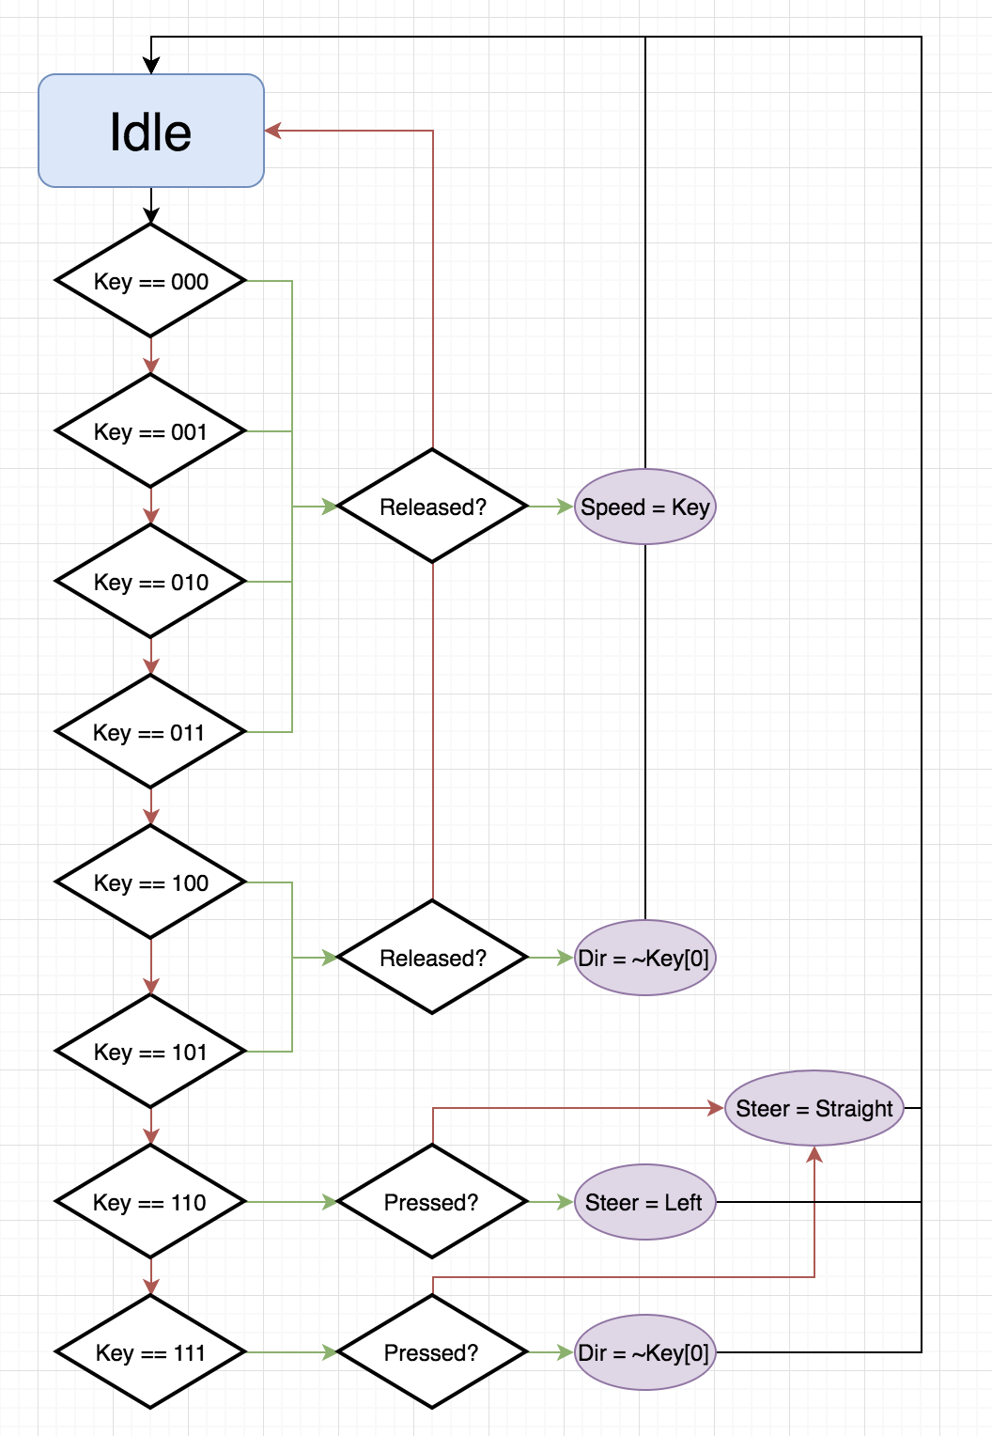
Controller
Notes:
NICK

Slide 11
Detailed Functionality - Sensors & Autonomous
Able to get accurate and stable distances from sensors.
Measure distance every 0.1 second
Update design from last version to be stabler
Display the distance of one of the front sensor on seven segments display
Four sensors work at the same time without affecting others.
2 in the front
2 on left and right
Use one signal to trigger all ultrasonic sensors to save I/O ports
The car can run autonomously according to the results get from the sensors.
FSM to control the car
Coordinate with motor drivers to make car move around safely
Notes:
Jason

Slide 12
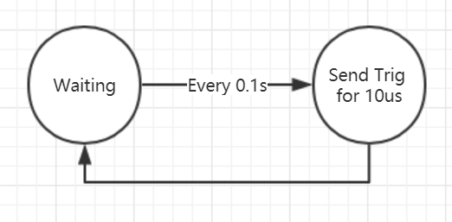
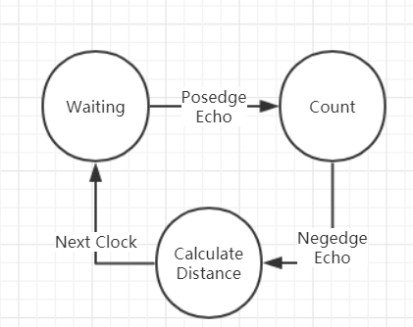
Sensors Block Diagrams
Ultrasonic Transmitter
Trig
V
10us
Echo Receiver
t
V
Echo
t
Start sending ultrasound (Set Echo to 5v)
Receive returned ultrasound(Set Echo to 0v)
Notes:
Jason

Slide 13
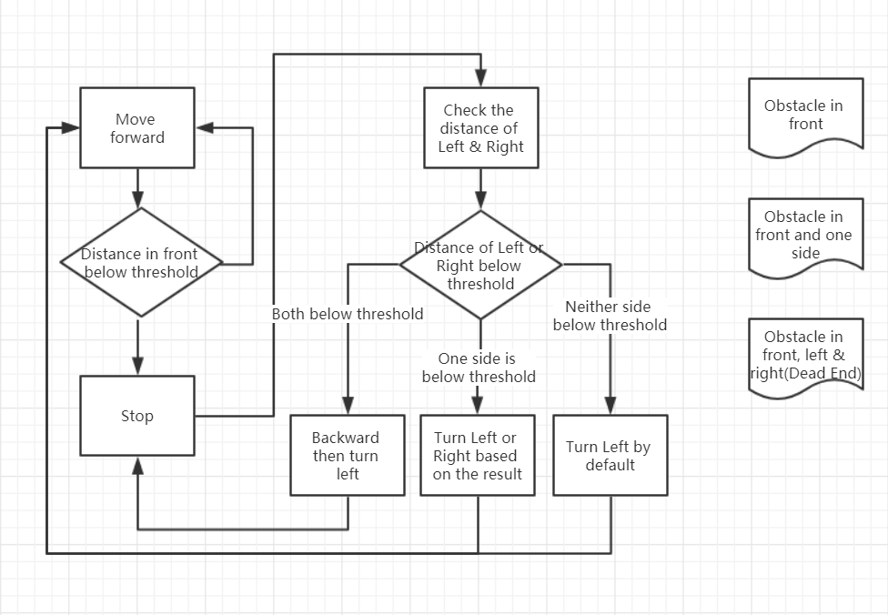
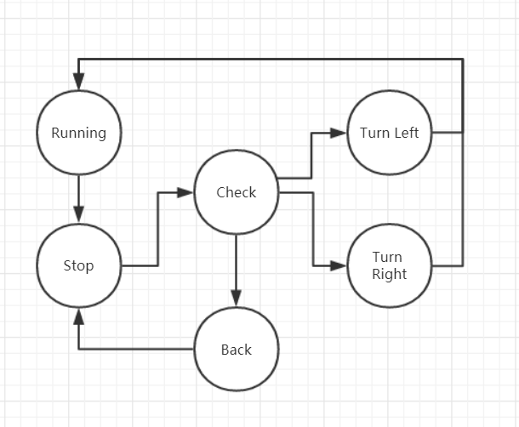
Autonomous Mode Diagram
The distances of going backward or turning are decided by the time staying at the corresponding state.
Notes:
Gan

Slide 14
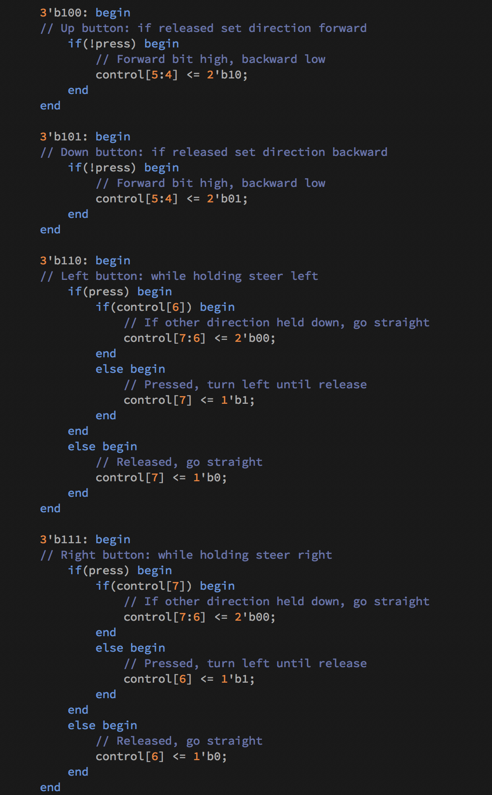
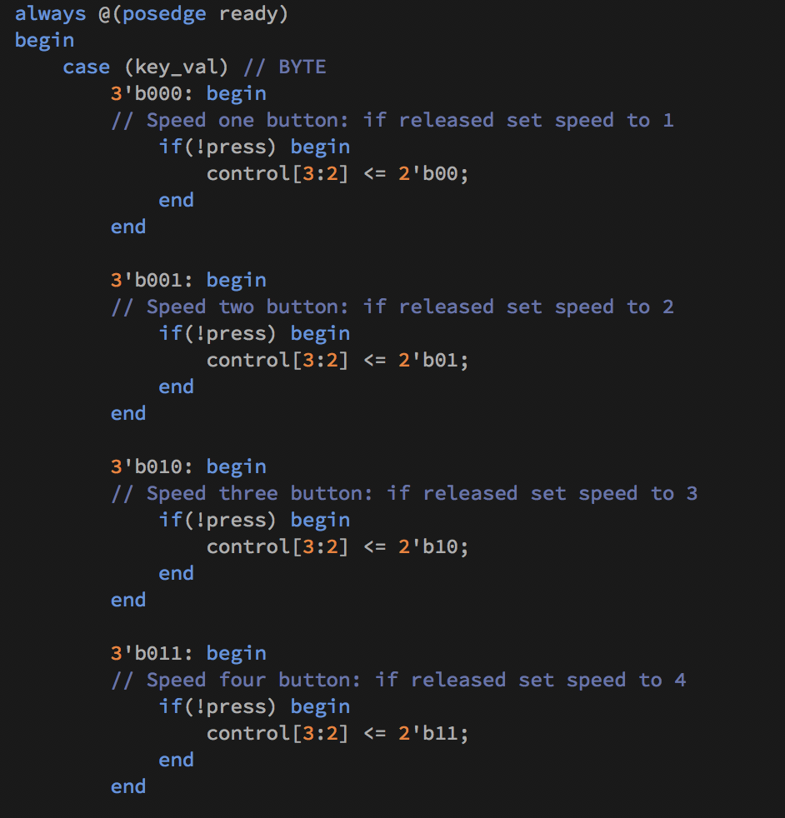
Verilog: BT Controller

Slide 15
Successes
Varying motor speed based on user input
Serial Communication between Phone, FPGA, and motor drivers
Feedback from sensors converted into control signals
Sensors and solderable breadboard mounted on car
Overall: Timing and interaction between the different peripherals and the FPGA is smooth

Slide 16
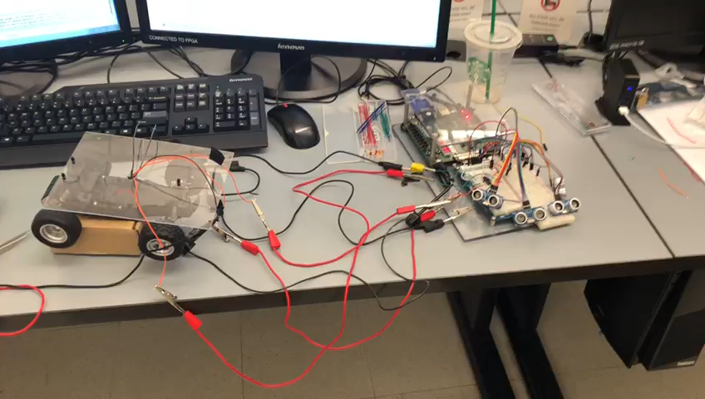
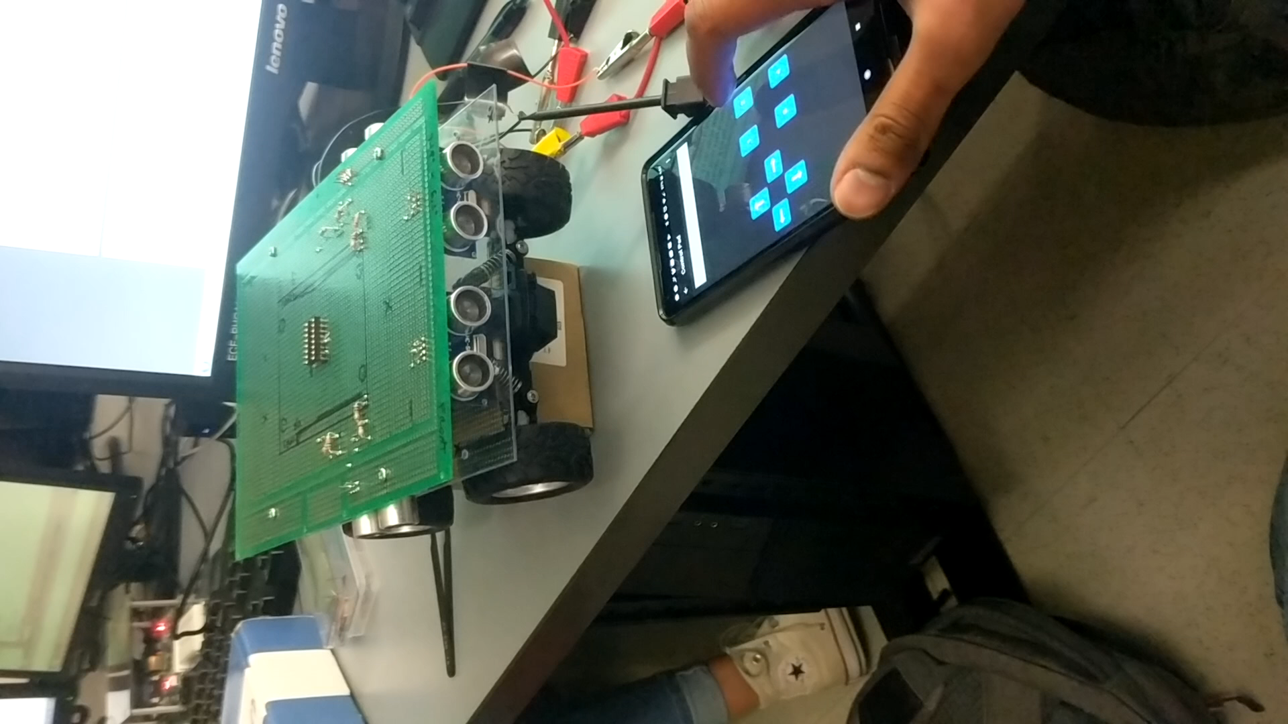
Videos
Manual Control
Autonomous Control
Notes:
Gan for autonomous

Slide 17
Failures and Obstacles
Bluetooth
Displaying sensor data (distance from objects) back on to the interface
Sensor
Did not implement the light sensors
Motors
Turning left is sometimes not as sharp as turning right
Turning in general is not as responsive when rear motors are at maximum speed

Slide 18
Tasks to be Done
Mount Microzed on board and connect inputs and outputs
Program Microzed to boot preprogrammed bitstream when battery powered
Transmit object distances to Phone App
More testing to fine tune parameters for autonomous mode
Notes:
BEN

Slide 19
Design Tradeoff Discussion
Microzed over Zedboard
Zedboard requires 12V, 5A power supply
Microzed only requires 5V, 2.5A, powered by microUSB
Smaller and easier to mount, lighter weight
Sensors
More sensors can let the car detect better, but it will use more I/O and add more weights.
Light sensors are cool, but gimmicky (simple leds don’t serve a real purpose or function in this case)

Slide 20
Attribution of Work
Mo - Bluetooth Parsing, Control structure, Feedback Data, App
Nick - Bluetooth Parsing, Control structure, Feedback Data, App
Gan - Sensors and autonomous mode
Zisen - Sensors and autonomous mode
Ben - Motor controller, physical mounting/wiring, and integration of control modes

Slide 21


